Slide 1
Heart Attack Analyis & Prediction Using Machine Learning
By Mohammed, Dalia & Rahaf

Slide 2
Table of contents
01
02
03
OverView
Preprocessing
Building & Evaluation
04
05
06
Deployment
Conclusion
References
Purpose of the project
Data Collection, Cleaning, Analysis & Feature Selection
Model Selection, Training & Evaluation
Model Extraction & web application
Project Summary, Limitations & Future Enhancements
References used for the project

Slide 3
01
OverView

Slide 4
Introduction
Heart attacks are a significant health concern, and timely prediction can help healthcare professionals take proactive measures and provide appropriate treatment.

Slide 5
17,900,000
According to The World Health Organization (WHO)
People died from CVDs in 2019
85% of these deaths were due to heart attack

Slide 6
Introduction
For that concern, this project aim to develop a machine learning model for predicting the early detection of heart attacks
Which will lead to better patient outcomes.

Slide 7
02
Data Preprocessing

Slide 8
Steps
Data Collection
Data Cleaning
Exploratory Data Analysis (EDA)
Feature Selection
The Dataset collected from Kaggle
1025 records with 14 features
The removing of Missing values, duplicate rows & Outliers
EDA allowed us to gain valuable insights and understand the underlying patterns in the dataset.
Least effective Features were removed using various method (later)

Slide 9
Exploratory Data Analysis (EDA)
EDA file link Final_Graduation_Project_Code.ipynb - Colaboratory (google.com)
51%
49%
With high risk of Heart Attack
With low risk of Heart Attack
Low risk 0
High risk 1

Slide 10
03
Model Building & Evaluation

Slide 11
Steps
Loading The Dataset
Training & Testing
Model fitting & creation
Prediction & Evaluation
Import dataset (Numeric)
0.8 training & 0.2 testing
Model Training using the processed dataset
Accuracy, precision & recall

Slide 12
Building & Evaluation
Random Forest
Imported Models
Best Model
Details
Accuracy | F1-Score. | Precision | Recall
86.43 | 87.52 | 82.05 | 93.20
85.85 | 85.99 | 85.58 | 86.41
84.39 | 85.96 | 78.40 | 95.15
80.49 | 81.98 | 76.47 | 88.35
98.54 | 98.52 | 100.00 | 97.09
1
K-Nearest Neighbors
2
Gradient Boosting
Decision Tree
3
Logistic Regression
4
Gradient Boosting
5
Naive Bayes
6
Support Vector Machine
7

Slide 13
04
Model Deployment

Slide 14
Deployment
Model Extraction
Streamlit App
The trained model was extract using pickle
A user-friendly Web application displays the presence of a heart attack based on the provided data.

Slide 15
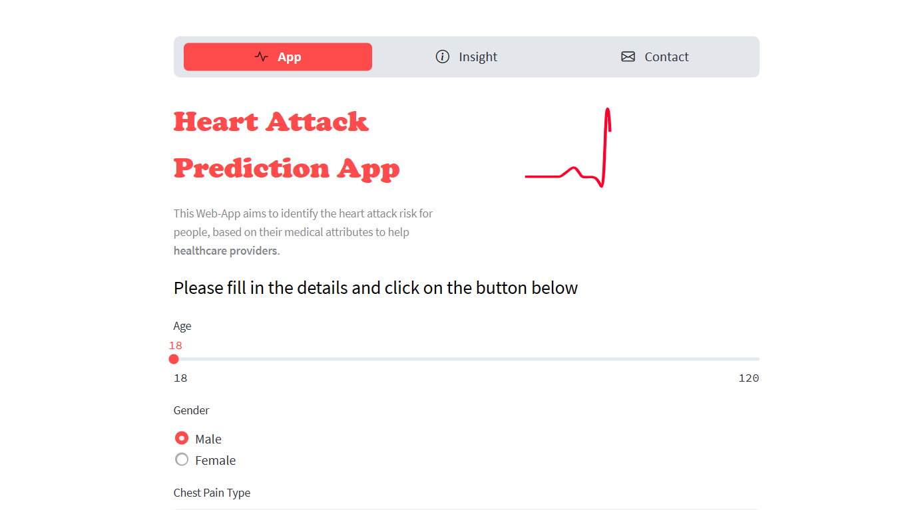
Website
https://heartml.streamlit.app

Slide 16
05
Conclusion & Future Work

Slide 17
Conclusions & Future Work
Our heart attack prediction system demonstrates promising results in accurately identifying individuals at high risk.
By integrating machine learning Approach with patient data, we provide a valuable tool for healthcare institutions to make informed decisions and implement preventive measures.

Slide 18
Conclusions & Future Work
Our future plans for the heart attack prediction project revolve around two key areas:
Enhancing model performance.
Integrating with health records server.
By pursuing these future plans, we can contribute to more effective early detection of heart attacks and better patient care, ultimately reducing mortality rates and improving cardiovascular health on a global scale.

Slide 19
06
References

Slide 20
References
Available upon request
-See documentation

Slide 21
Awesome words

